Slide 1




PDS
AWS Route 53 (DNS)
Computer Vision
https://github.com/siagianp
https://www.youtube.com/@AmelOline/videos
https://github.com/amelcharolinesgn2/Cloud-Infrastructures
https://github.com/amelcharolinesgn2/ClouD-Infrastructure-SISKA-2025
https://github.com/amelcharolinesgn2/CCNA1
https://github.com/amelcharolinesgn2/CCNA2
https://github.com/amelcharolinesgn2/AWS Certificate
Notes:
Lab Session 01: AWS Compute Foundations – EC2, Networking, and Application Deployment Lab Session 02: Identity and Access Control with IAM Lab Session 03: Cloud Storage Solutions – S3, EBS, and EFS Lab Session 04: Database Services – RDS, DynamoDB, and ElastiCache Lab Session 05: Load Balancing and Auto Scaling Lab Session 06: Container Orchestration with ECS, Fargate, and EKS Lab Session 07: Serverless Computing with Lambda Lab Session 08: Monitoring, Logging, and Security Auditing Lab Session 09: Infrastructure as Code – CloudFormation, CDK, and Terraform Lab Session 10: CI/CD Pipelines – App Runner, CodePipeline, GitHub Actions, and CodeDeploy Lab Session 11: AI/ML Services – Rekognition, Comprehend, Translate, and SageMaker Lab Session 12: Hybrid Cloud Networking – VPC Peering, Transit Gateway, VPN, and Direct Connect Lab Session 13: Security and Compliance – AWS Config, GuardDuty, Security Hub, and KMS Lab Session 14: Disaster Recovery and Business Continuity – AWS Backup, Multi-Region, and Failover Lab Session 15: Migration and Modernization – DataSync, DMS, MGN, Containers, and Serverless
Lab Session 16: Cost Management and Optimization – Cost Explorer, Trusted Advisor, Budgets, and Well-Architected
https://www.youtube.com/watch?v=SOTamWNgDKc&t=19604s

Slide 2
AWS Route 53 (DNS)
Enhancing Domain Management and Global Traffic Optimization

Slide 3
Agenda
Introduction to Route 53
Key Features and Benefits
Routing Policies
Hosted Zones and Record Types
Integration with AWS Services
Use Cases
Real-World Examples
Demo (Optional)
Summary

Slide 4

Amazon Route 53
A highly available and scalable Domain Name System (DNS) web service from AWS.
Primary Functions:
Domain registration.
DNS routing.
Health checks and traffic management.
Why Route 53?
Global availability.
Seamless integration with AWS services.
Highly reliable and secure.

Slide 5
Key Features and Benefits
Features:
Domain Registration: Register and manage domain names directly from AWS.
DNS Management: Create and manage DNS records for domains.
Health Checks: Monitor the health of resources and reroute traffic if needed.
Traffic Flow: Optimize traffic globally with routing policies.
Integration: Works seamlessly with other AWS services.
Benefits:
High Availability: Built-in redundancy for reliable DNS service.
Scalability: Supports traffic for large-scale applications.
Security: DNSSEC support for secure DNS management.

Slide 6
Routing Policies
Simple Routing: Basic DNS resolution for a single resource.
Weighted Routing: Distribute traffic based on assigned weights.
Latency Routing: Directs traffic to the region with the lowest latency.
Geolocation Routing: Routes traffic based on user location.
Failover Routing: Ensures high availability by redirecting traffic to a backup resource.
Multi-Value Answer: Returns multiple IP addresses for redundancy.

Slide 7
Hosted Zones and Record Types
Hosted Zones:
Public Hosted Zone: Manages DNS records for domains accessible on the internet.
Private Hosted Zone: Manages DNS records for internal AWS resources.
Record Types:
A (Address Record): Maps domain to an IPv4 address.
AAAA: Maps domain to an IPv6 address.
CNAME: Alias for another domain name.
MX: Mail exchange server.
TXT: Holds text information for verification or other purposes.

Slide 8
Integration with AWS Services
Works seamlessly with services like:
Elastic Load Balancer (ELB) for distributing traffic.
CloudFront for content delivery.
S3 for static website hosting.
Enables advanced configurations:
Automatically updates DNS records for Auto Scaling groups.
Secure domain connections with ACM (provides SSL).

Slide 9
Use Cases
E-commerce Platforms:
Efficiently handle global traffic with geolocation routing.
Global Applications:
Ensure low-latency access using latency-based routing.
Disaster Recovery:
Maintain availability using failover routing.

Slide 10
Real-World Example
A global SaaS provider uses Route 53 for:
Managing domains across regions.
Ensuring high availability with failover routing.
Optimizing user experience with latency-based routing.
Metrics:
Improved global accessibility.
99.99% uptime for critical applications.

Slide 11
Demo
Step 1: Create a hosted zone in the AWS Management Console.
Step 2: Add DNS records (A, CNAME, etc.).
Step 3: Configure routing policies.
Step 4: Test DNS resolution using tools like nslookup.

Slide 12
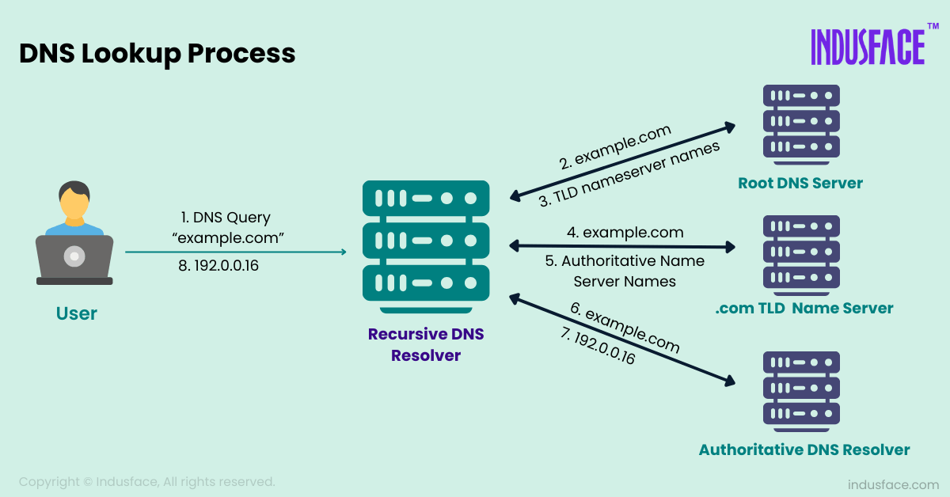
DNS Lookup Process

Slide 13
Summary
Route 53 offers a scalable and reliable DNS service.
Supports advanced traffic management with various routing policies.
Seamless integration with AWS services ensures global optimization.

Slide 14
THANK YOU
Amel charoline
Amel Online & Irene magdalena
https://github.com/siagianp
https://www.youtube.com/@AmelOline/videos
https://github.com/amelcharolinesgn2/Cloud-Infrastructures
https://github.com/amelcharolinesgn2/ClouD-Infrastructure-SISKA-2025
https://github.com/amelcharolinesgn2/CCNA1
https://github.com/amelcharolinesgn2/CCNA2
https://github.com/amelcharolinesgn2/AWS Certificate

